Slide 1
Module-3 Pointers

Slide 2
Introduction
When programming with C, there are too many things that can only be done with pointers.
In many cases, C programmers use pointers because they make the code more efficient.
But at the same time, pointers seem to make the code harder to understand.
Pointers are a powerful programming construct.
.

Slide 3
Memory Address
All computers have primary memory-RAM
RAM holds the programs that the computer is currently running + the data they are currently manipulating.
All the variables used in a program reside in the memory during execution.
When a program in C is compiled, the compiler will allocate the memory necessary to run the program.

Slide 4
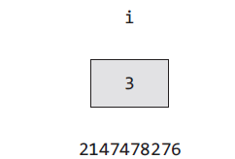
Address Operator (&)
The memory address is an integer specifying the location where something resides.
Consider the declaration :
int i =3;
This declaration tells the C compiler to reserve space in memory to hold the integer value and associate the name i with that memory location
The memory is shown here :
Scanf (“%d”, &i);
printf(“\n Address of i = %u”, &i);

Slide 5
Declaration of Pointers
Every pointer must be declared.
It will occupy a certain number of memory space.
A pointer variable is declared by preceding its name with an asterisk.
SYNTAX :
datatype * pointer_variable;
.

Slide 6
The * (or) indirection operator
The indirection operator is an asterisk (*)
The pointer operator available in C is ‘*’, called ‘value at address’ operator (dereferencing).
The placement of the * operator before a pointer is said to dereference the pointer.
It returns the value stored at a particular address.

Slide 7
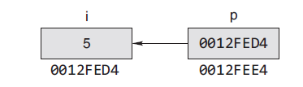
Pointer
A pointer provides a way of accessing a variable without referring to the variable directly.
A pointer variable is a variable that holds the memory address of another variable, i.e., they ‘point’ to a particular point in memory.
int i =5, *p;
p=&i; //address of i
printf(“%d”,*p);
Datatype of the variable and pointer must be the same.

Slide 8
Example - Declaring a Pointer
int *p1 /*Pointer to an integer variable*/
double *p2 /*Pointer to a variable of data type double*/
char *p3 /*Pointer to a character variable*/
float *p4 /*pointer to a float variable*/
a pointer variable is always bound to a specific data type (except void pointer).

Slide 9
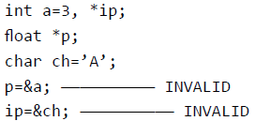
Invalid pointer assignment
Float pointer should store only float value
?

Slide 10
Initializing Pointer
Pointer is initialized with a specified Address/0/NULL prior to its use.
Eg:
int a, *p;
p=&a;
A pointer must not be used until it is assigned a meaningful address.
To use a pointer that has not been initialized properly will cause unpredictable results

Slide 11
Int a = 10
Int takes 4 bytes to store a variable.
int a=10 will take 4 bytes to store the value (i.e. 10). But only the first-byte address is mentioned
Initialize the pointer:
Int *p;
p=&a;
……………………..
Int *p=&a; //valid
Int a=10, *p=&a; //valid
Int *p=&a, a=10; //invalid because address assigned before initializing a.
Var | a
Value | 10
address | 100
100 | 101 | 102 | 103 | 104 | 105 | 106
Var | p
Value | 100
address | 210

Slide 12
Example Programs(sum of two numbers using pointers)
int main() { int first, second, *p, *q, sum;
printf("Enter two integers to add\n"); scanf("%d%d", &first, &second);
p = &first; q = &second;
sum = *p + *q;
printf("Sum of the numbers = %d\n", sum);
return 0; }

Slide 13
Int a=10, b=20
Int *p, *q; // or you can write *p=&a combining the 2nd and 3rd line.
p=&a;
q=&b;
Printf(“value of a = %d”, a); = 10
Printf(“a = %d”, *p); => *p=*(&a) = *(100) = 10
Printf(“address of a = %x”, &a); = address of a in hexadecimal
Printf(“address of a = %x”, p); = address of a in hexadecimal
Printf(“address of p = %x”, &p); = address of p in hexadecimal
a
b
10
20
100
200
p
q
100
200
300
400

Slide 14
Pointer Assignment
Int a=10, b=20
Int *p=&a, *q=&b;
Printf(“values = %d%d%d”, a,*p,*q); = 10, 10, 20
*q=*p;
Printf(“value of = %d%d%d”, a,*p,*q); = 10, 10, 10
//Question: what will happen if we write…..
q=p;
Printf(“value of a = %d%d%d”, a,*p,*q); = ?, ?, ?
q will have the address of p i.e 100. So *q will also print 10
a
b
10
20
100
200
p
q
100
200
300
400

Slide 15
Pointer to Pointer or double pointer
Int a=10;
Int *p=&a,
Int **q=&p; // data type will be same as of a, bcz q is holding p, and p is holding a
Printf(“values = %d%d%d”, a,*p,*q); = 10, 10, 100
Printf(“values = %d%d%d”, a,*p,**q); = 10, 10, 10
/* the above red line can be written as follows
Int *p, **q;
p=&a;
*q=&p; */
// int ***r = &q //// triple pointer
a
r
10
400
100
500
p
q
100
300
300
400

Slide 16
Pointer Arithmetic
Pointer is an address, i.e., a numeric value.
Arithmetic operations like =, +, -, ++, --, <, > can be performed
Valid operations:
Assignment of pointers to the same type of pointers
Adding or subtracting a pointer and an integer
Comparing two pointers (within array limits) that point to the elements of an array.
Incrementing or decrementing the pointers (within array limits) that point to the elements of an array.
Subtraction of pointers- (p-q=3 tells that q is 3 elements away from p in an array)

Slide 17
Illegal Arithmetic Operations
Address + Address = illegal
Address * Address = illegal
Address % Address = illegal
Address / Address = illegal
Address & Address = illegal
Address ^ Address = illegal
Address | Address = illegal
~Address = illegal

Slide 18
Addition in pointer (in normal variable)
Int a=10;
Int *p=&a;
p=p+1 /// 100 101 102 103 104 105 106 107
// p=100, so p=100+1=101. => WRONG
//p=p+1 means next address.. In case of int next address is after 4 bytes.
// so p=p+1 => means p=100+4=104 (so pointer will point to 104)
// p=p+n => p=p+(0+4n)
Printf(“%d”, *p); // this will print a garbage value as there is nothing at 104 address.
So it is not very useful when we deal with normal variables. It is useful when we deal with the array.
a
10
100
p
100
300

Slide 19
Addition in pointer (in arrays)
a
Int a[]=(1,2,3,4,5,6};
Int *p=&a[0];
100 104 108 112 116 120 124 128
// a is also a pointer. But a is a constant pointer. a+n will not be applicable. It will always contain the base address i.e. the first address.
//P=&a
//P+n=&a[0+n]
Printf(“%d”, *p);--- 1
P=p+2;
printf (“%d”, *p);--- 3
P+1;
Printf(“%d”, *p); ????? P+1 is not saved somewhere.
-----
*p=2;
Printf(“%d”, *p); ----- 2
100
200
1 | 2 | 3 | 4 | 5 | 6 | 7 | 8
p
100
300

Slide 20
Subtraction in pointer (in arrays)
a
Int a[]=(1,2,3,4,5,6};
Int *p=&a[2];
100 104 108 112 116 120 124 128
//P=&a
//P-n=&a[0-n]
Printf(“%d”, *p);--- 3 //if ptr is pointing to 3
P=p-2;
printf (“%d”, *p);--- 1
P-1;
Printf(“%d”, *p); ????? P-1 is not saved somewhere.
-----
*p=2;
Printf(“%d”, *p); ----- 2
100
200
1 | 2 | 3 | 4 | 5 | 6 | 7 | 8
p
108
300

Slide 21
Void pointers
A void pointer:- point to any data type or a general-purpose pointer
Its sole limitation is that the pointed data cannot be referenced directly
type casting must be used to turn the void pointer to a pointer of a concrete data type
int a;
void *vp;
vp = &a;
(int*) vp // Type casting
*((int*)vp) // Dereferences the type casted void pointer variable

Slide 22
NULL pointer
Pointer variable is initialized to a value guaranteed in such a way that it is certainly not to point to any C object or function.
A pointer initialized in this manner is called a null pointer, which points to NO-WHERE.
Eg.
#include <stdio.h>
int *ip = NULL;

Slide 23
Important points
Use of NULL pointer : To initialize a pointer variable when that pointer variable isn’t assigned any valid memory address yet.
NULL vs Void Pointer – Null pointer is a value, while void pointer is a type.
They are totally different – comparing a car and a carrot.

Slide 24
Dynamic Memory Allocation

Slide 25
Introduction
Dynamic Memory Allocation: Allocation of memory at run-time (execution)
The area from where the application gets dynamic memory is called heap.
Two ways of memory allocation :
1. Static : by means of variable declaration and accessed by means of & operator
2. Dynamic : by means of malloc() and calloc() functions

Slide 26
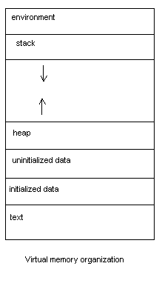
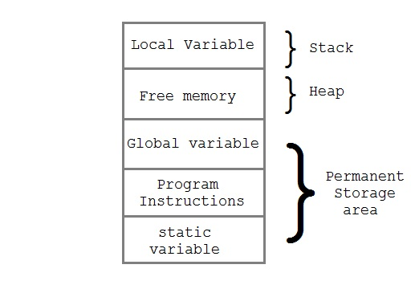
Memory Map

Slide 27
malloc()
malloc stands for "memory allocation".
Syntax :
void* malloc(size_t size)
Where,
size is a continuous block of memory in the heap
size_t is unsigned long
It returns a void pointer to the heap block or NULL
malloc() with zero size should not be called which produces unpredictable response

Slide 28
Malloc
The “malloc” or “memory allocation” method in C is used to dynamically allocate a single large block of memory with the specified size. It returns a pointer of type void which can be cast into a pointer of any form. It doesn’t Initialize memory at execution time so it initializes each block with the default garbage value initially.
Syntax:
ptr = (cast-type*) malloc(byte-size) For Example:
ptr = (int*) malloc(100 * sizeof(int)); Since the size of int is 4 bytes, this statement will allocate 400 bytes of memory. And, the pointer ptr holds the address of the first byte in the allocated memory.

Slide 29
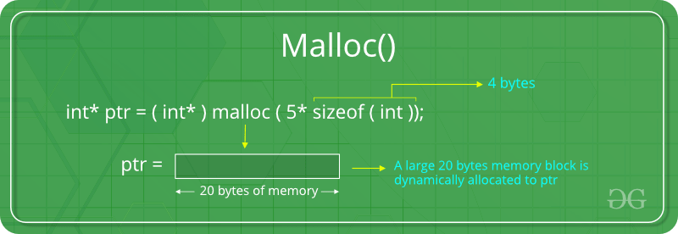
#include <stdio.h>
#include <stdlib.h>
int main()
{
int* ptr;
int n, i;
printf("Enter number of elements:");
scanf("%d",&n);
// Dynamically allocate memory using malloc()
ptr = (int*)malloc(n * sizeof(int));
// Check if the memory has been successfully allocated by malloc or not
if (ptr == NULL) {
printf("Memory not allocated.\n");
exit(0); }
else {
printf("Memory successfully allocated using malloc.\n");
for (i = 0; i < n; ++i) {
ptr[i] = i + 1;
}
printf("The elements of the array are: ");
for (i = 0; i < n; ++i) {
printf("%d, ", ptr[i]);
} }
return 0;}
Output:
Enter number of elements: 5
Memory successfully allocated using malloc.
The elements of the array are: 1, 2, 3, 4, 5,

Slide 30
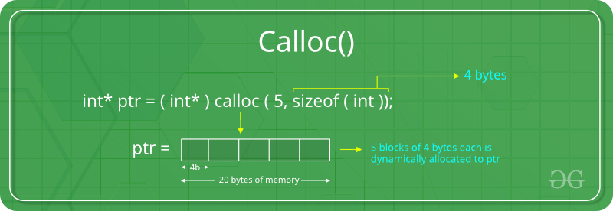
calloc()
“calloc” or “contiguous allocation” method in C is used to dynamically allocate the specified number of blocks of memory of the specified type. it is very much similar to malloc() but has two different points and these are:
It initializes each block with a default value ‘0’.
It has two parameters or arguments as compare to malloc().
ptr = (cast-type*)calloc(n, element-size);
here, n is the no. of elements and element-size is the size of each element.
For Example:
ptr = (float*) calloc(25, sizeof(float)); // This statement allocates contiguous space in memory for 25 elements each with the size of the float.

Slide 31
free()
Dynamically allocated memory created with either calloc() or malloc() doesn't get freed on its own.
use free() to release the space.
Syntax:
void free(void* block)
Takes a pointer to a heap block earlier allocated by malloc/calloc.

Slide 32
realloc()
Helps to resize (extend / reduce ) the previously allocated memory.
Parameters passed are existing block in the heap and the new size (bigger / smaller).
It returns a pointer to the newly allocated memory in the heap.

Slide 33
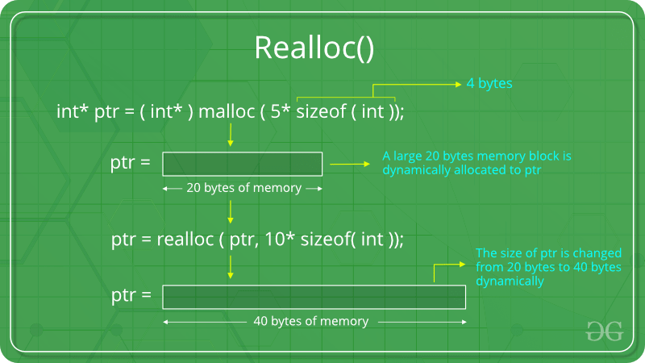
realloc()
“realloc” or “re-allocation” method in C is used to dynamically change the memory allocation of a previously allocated memory. In other words, if the memory previously allocated with the help of malloc or calloc is insufficient, realloc can be used to dynamically re-allocate memory. re-allocation of memory maintains the already present value and new blocks will be initialized with the default garbage value.
Syntax:
ptr = realloc(ptr, newSize); where ptr is reallocated with new size 'newSize'.
If space is insufficient, allocation fails and returns a NULL pointer.
If ptr is NULL, then it will act as malloc() and if newSize is NULL, then it will act as free().

Slide 34
Pointers and One-Dimensional Arrays

Slide 35

Arrays and Pointers
Array is a contiguous block of memory
Elements are stored in continuously increasing locations.
Base address is the beginning address location.
Array notation is a form of pointer notation.
Array name is referred to an address constant.

Slide 36
Using Pointers with Arrays
Consider the program fragment.
char str[10], *p1;
p1=str;
To access the 3rd element,
str[2] or *(p1+2)
Here, name of the array is the pointer and offset from base address is represented as an integer

Slide 37
Iterating Through the Array
The usual way of iterating through the array a:
int j;
for(j = 0; j < n; j++)
a[j]++;
Using pointer arithmetic,
int *pj;
for(pj = a; pj < a + n; pj++)
(*pj)++;

Slide 38
Iterating Through the Array
int x[4] = {12, 20, 39, 43}, *y;
y = &x[0]; // y points to the beginning of the array
printf("%d\n", x[0]); // outputs 12
printf("%d\n", *y); // also outputs 12
printf("%d\n", *y+1); // outputs 13 (12 + 1)
printf("%d\n", (*y)+1); // also outputs 13
printf("%d\n", *(y+1)); // outputs x[1] or 20
y+=2; // y now points to x[2]
printf("%d\n", *y); // prints out 39

Slide 39
Iterating Through the Array
*y = 38; // changes x[2] to 38
printf("%d\n", *y-1); // prints out x[2] - 1 or 37
*y++; // sets y to point at the next
array element
printf("%d\n", *y); // outputs x[3] (43)
(*y)++; // sets what y points to to be 1
greater
printf("%d\n", *y); // outputs the new value of
x[3] (44)

Slide 40
Pointers and Functions

Slide 41
Passing pointers to functions
Passing pointers to functions is known as Call by reference.
Address of the variable is passed instead of the value.
Function declaration will look like this :
void swapnum(int *, int *);
Passing pointer while calling :
swapnum( &v1, &v2 );
The called function will look like this :
void swapnum(int *num1, int *num2)

Slide 42
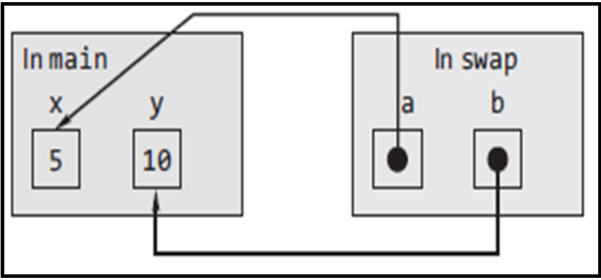
Example - Call by reference

Slide 43
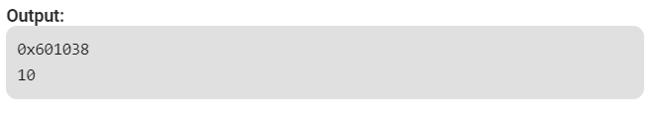
Returning pointers from a function
It is also possible to return a pointer from a function.
int* fun()
{
static int A = 10;
return (&A);
}
int main()
{
int* p; // Declare a pointer
p = fun(); // Function call
printf("%u\n", p);
printf("%d\n", *p);
return 0;
}

Slide 44
Returning more than one value from a function
Pointers allow the programmer to ‘return’ more than one value by allowing the arguments to be passed by address.
void swapValue(int *a,int *b);
int main()
{
int a = 100;
int b= 200;
printf("First number is %d",a);
printf("Second Number is %d",b);
swapValue(&a,&b);
printf("After swap function \n");
printf("%d\n%d",a,b);
}
void swapValue (int *x , int *y)
{
int temp;
temp = *x;
*x=*y;
*y=temp;
}
Output:
First number is 100
Second Number is 200
After swap function
200
100

